Slide 1
Lecture 11 : CSE2004 – DBMS
normalization

Slide 2
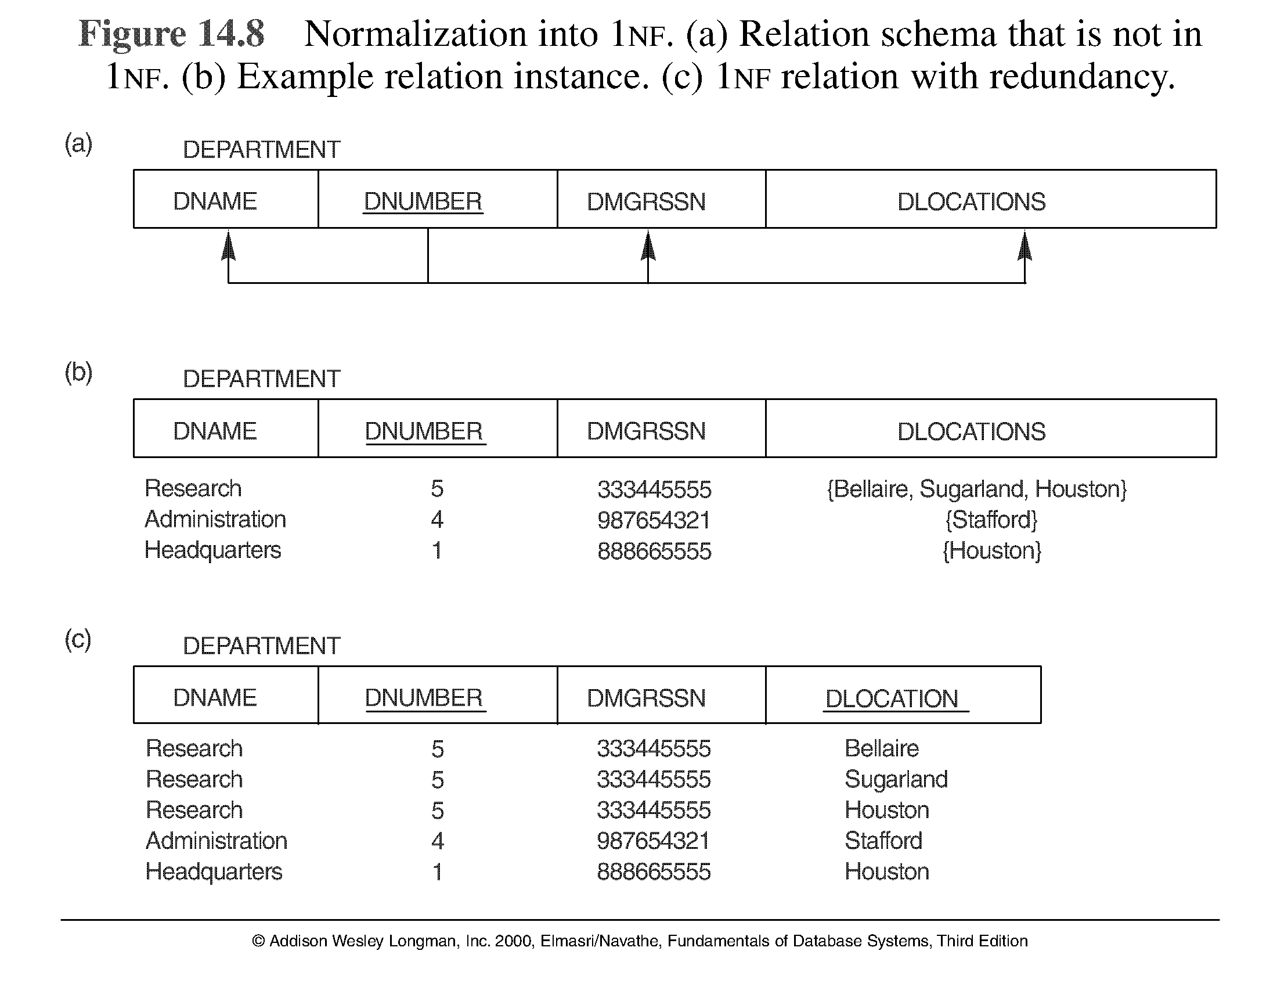
First Normal Form
Disallows composite attributes, multivalued attributes, and nested relations; attributes whose values for an individual tuple are non-atomic
Considered to be part of the definition of relation

Slide 3
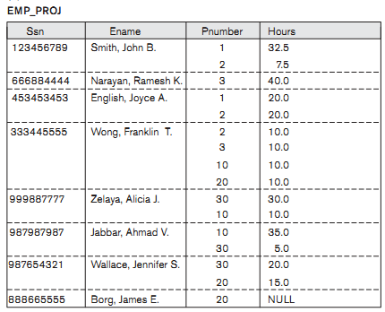

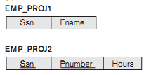

Slide 4
Second Normal Form
Uses the concepts of FDs, primary key
Definitions:
Prime attribute - attribute that is member of the primary key K
Full functional dependency - a FD Y -> Z where removal of any attribute from Y means the FD does not hold any more
Examples: - {SSN, PNUMBER} -> HOURS is a full FD since neither SSN -> HOURS nor PNUMBER -> HOURS hold
- {SSN, PNUMBER} -> ENAME is not a full FD (it is called a partial dependency ) since SSN -> ENAME also holds

Slide 5
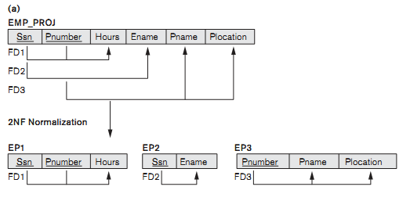
Second Normal Form
A relation schema R is in second normal form (2NF) if every non-prime attribute A in R is fully functionally dependent on the primary key
R can be decomposed into 2NF relations via the process of 2NF normalization

Slide 6
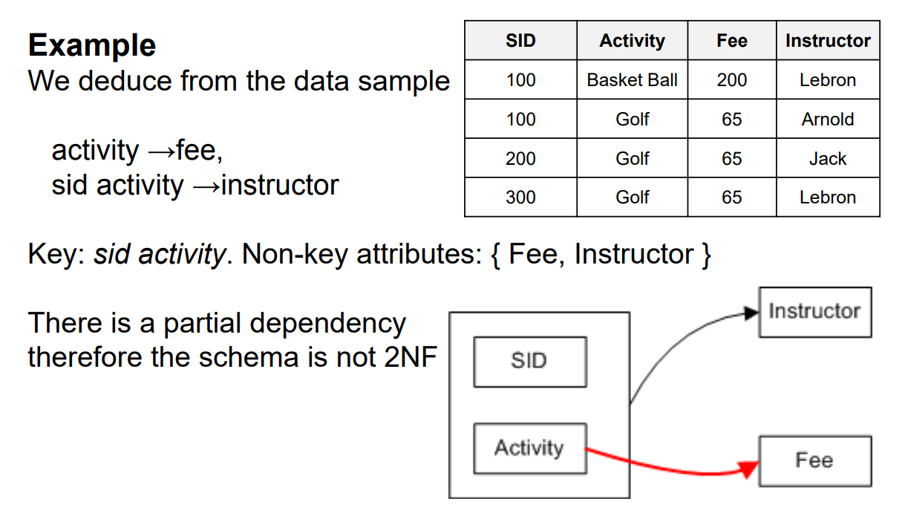

Slide 7
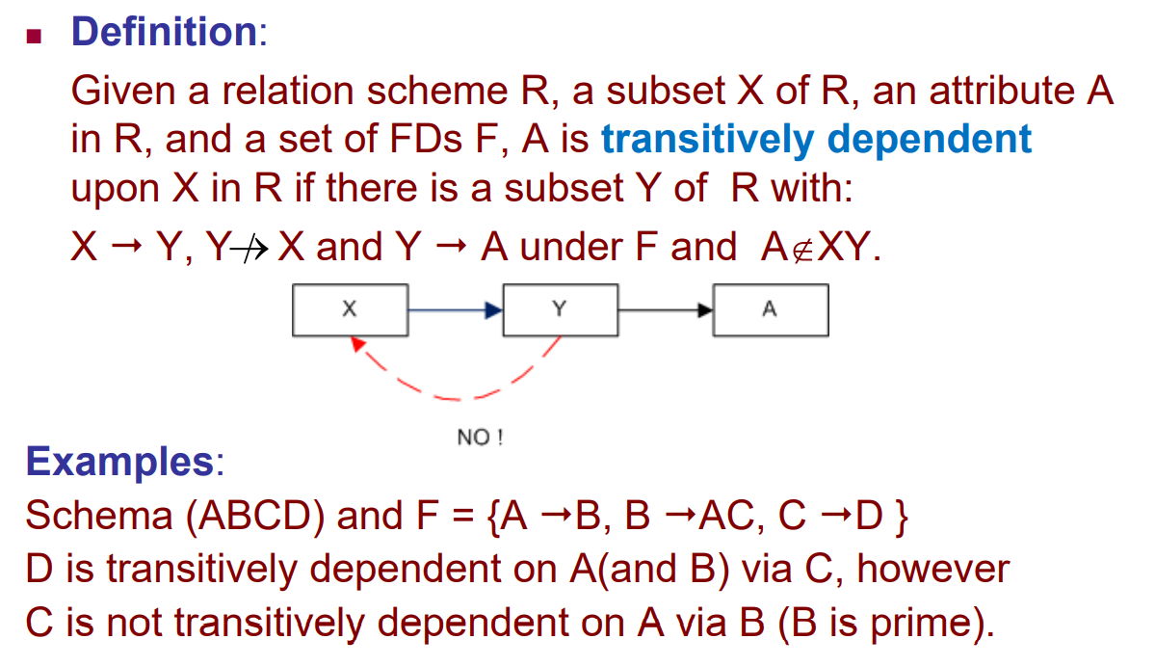
Third Normal Form (3NF)

Slide 8
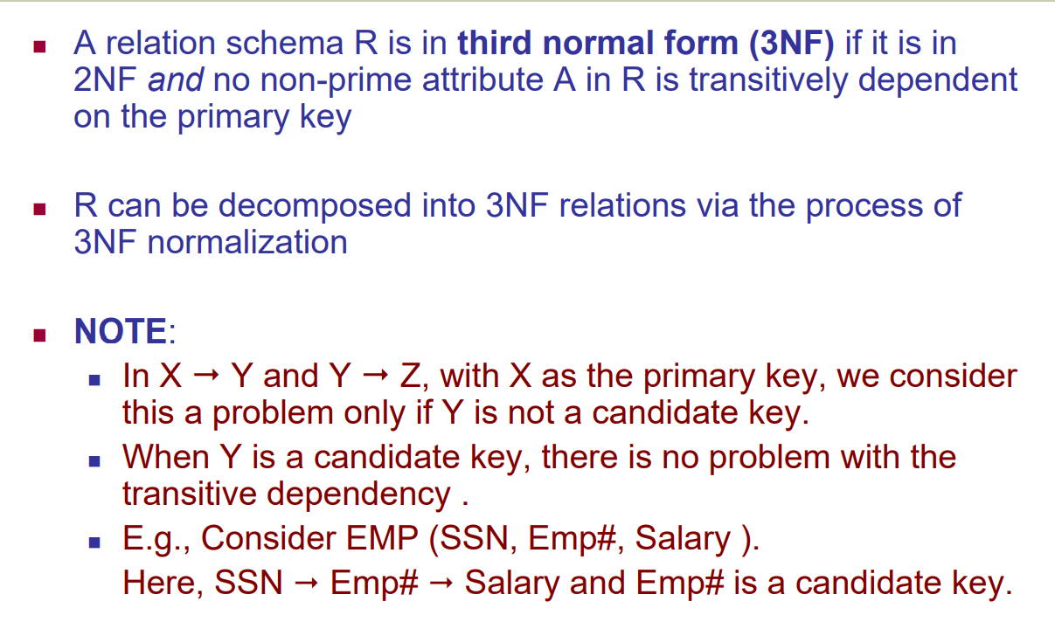
Third Normal Form (3NF)

Slide 9
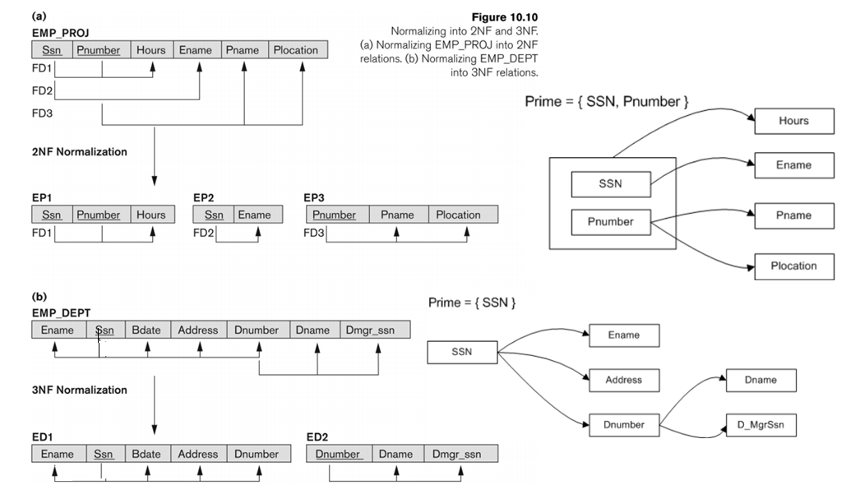

Slide 10
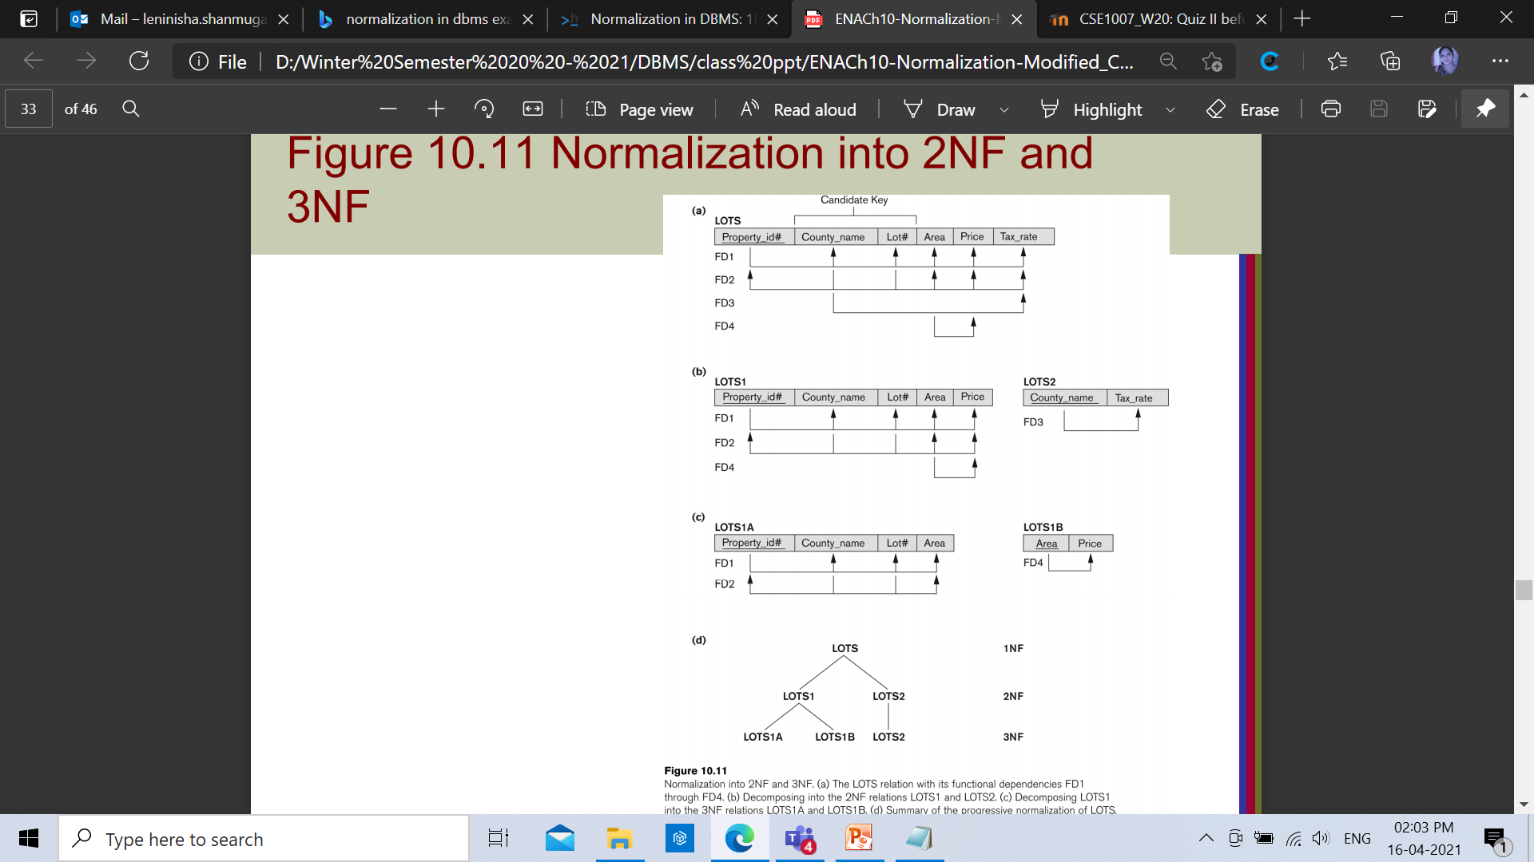

Slide 11
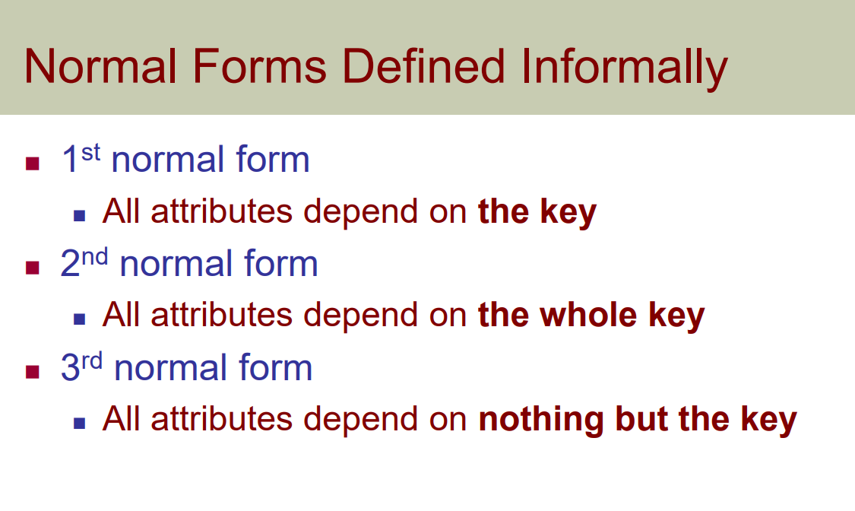

Slide 12
3NF?
Student ID | Student Name | Subject ID | Subject | Address
18-Uni-205 | Ali | 01 | DATABASE | California
19-Uni-335 | Rashid | 02 | DLD | Pakistan
17-Uni-832 | Zafar | 03 | C++ | United States
18-Uni-192 | Asad | 04 | DLD | United Kingdom

Slide 13
3NF
Student ID | Student Name | Subject ID | Address
18-Uni-205 | Ali | 01 | California
19-Uni-335 | Rashid | 02 | Pakistan
17-Uni-832 | Zafar | 03 | United States
18-Uni-192 | Asad | 04 | United Kingdom
Subject ID | Subject
01 | DATABASE
02 | DLD
03 | C++
04 | DLD

Slide 14
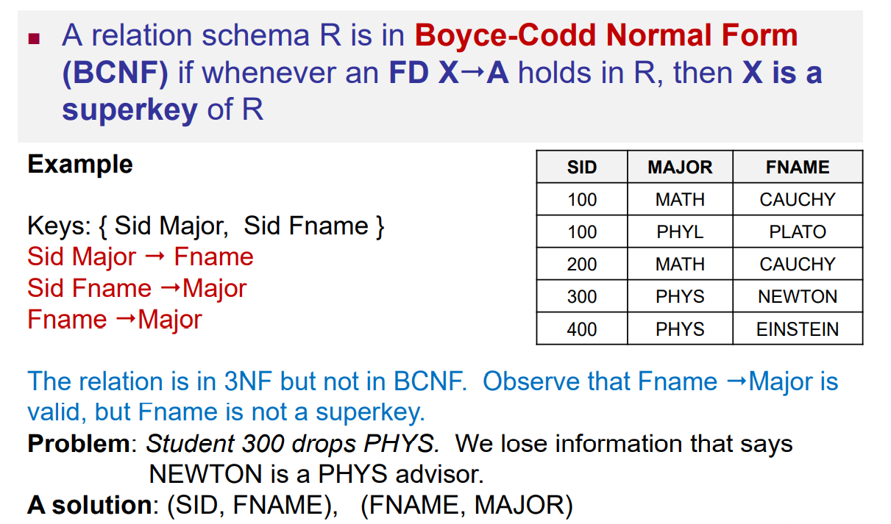
Boyce – Codd Normal Form (BCNF)

Slide 15
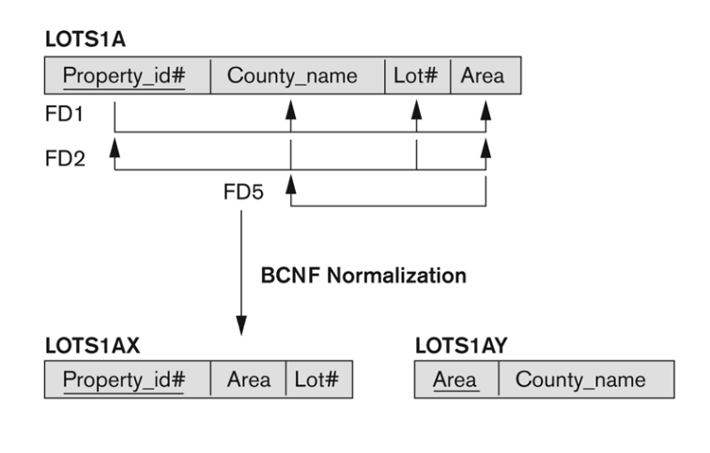

Slide 16


Slide 17
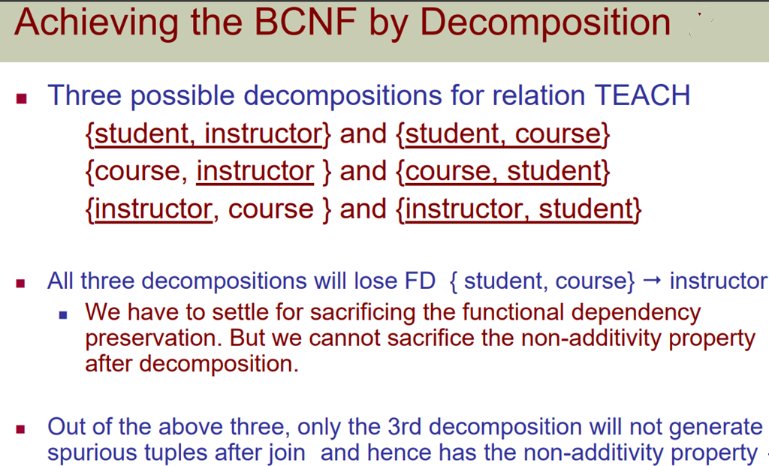

Slide 18
Thank you

